Slide 1
Khuong Dinh Lower Secondary School
Class: 8A9
Teacher: Dong Thi Thuy Huong
Khuong Dinh Lower Secondary School

Slide 2
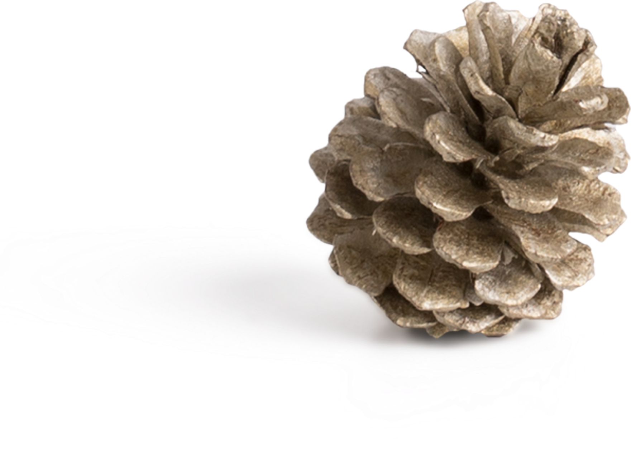
Unit 5
WONDERS OF VIETNAM
Period 35
Lesson 2: A closer look 1

Slide 3
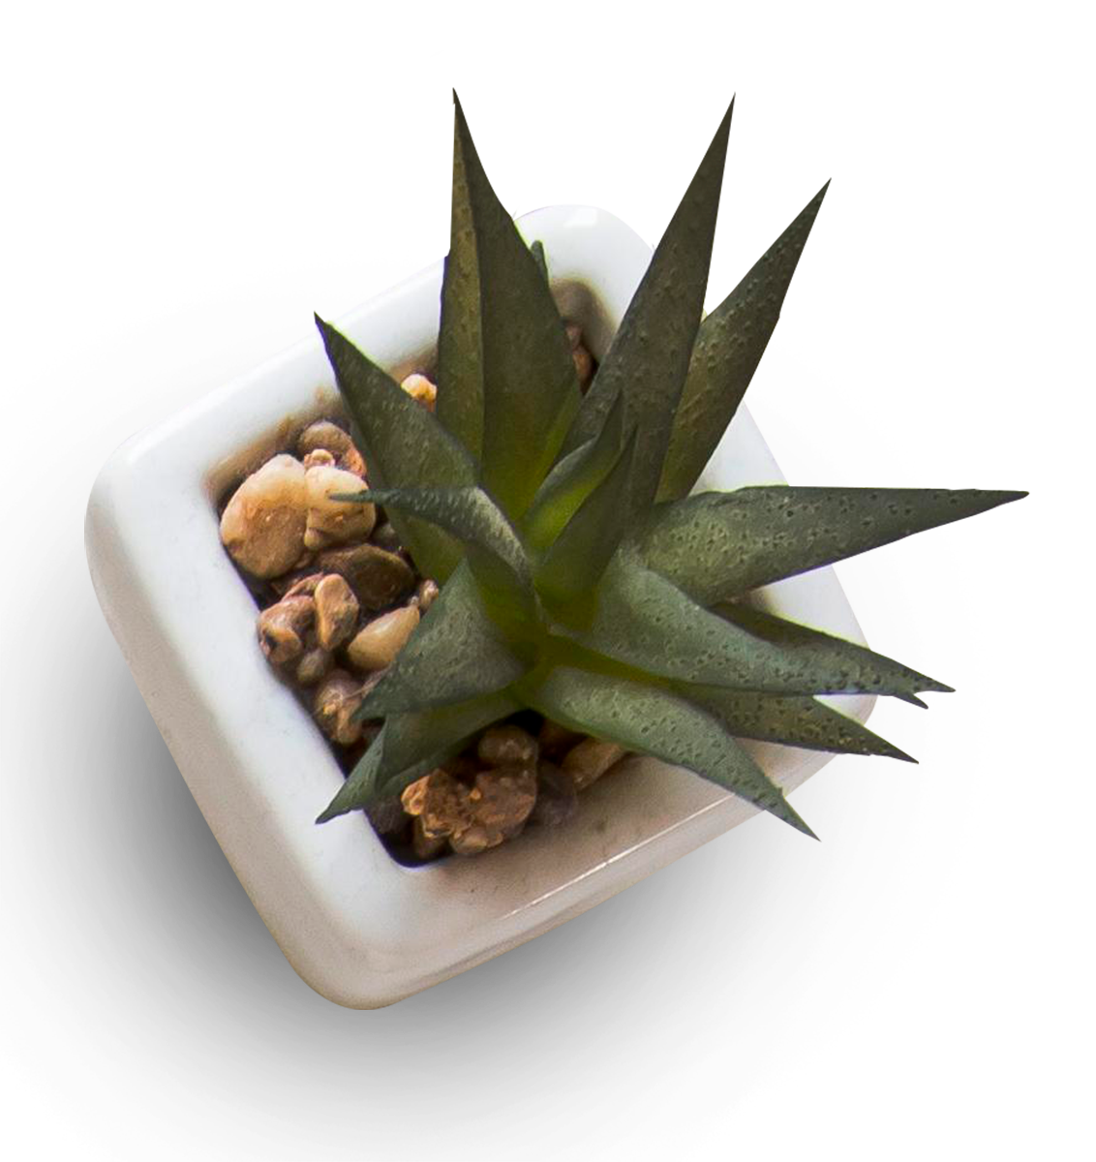
Table of CONTENTS
01
Homework checking
02
Vocabulary
03
Pronunciation
Nouns & adjectives
Short words in a sentence

Slide 4
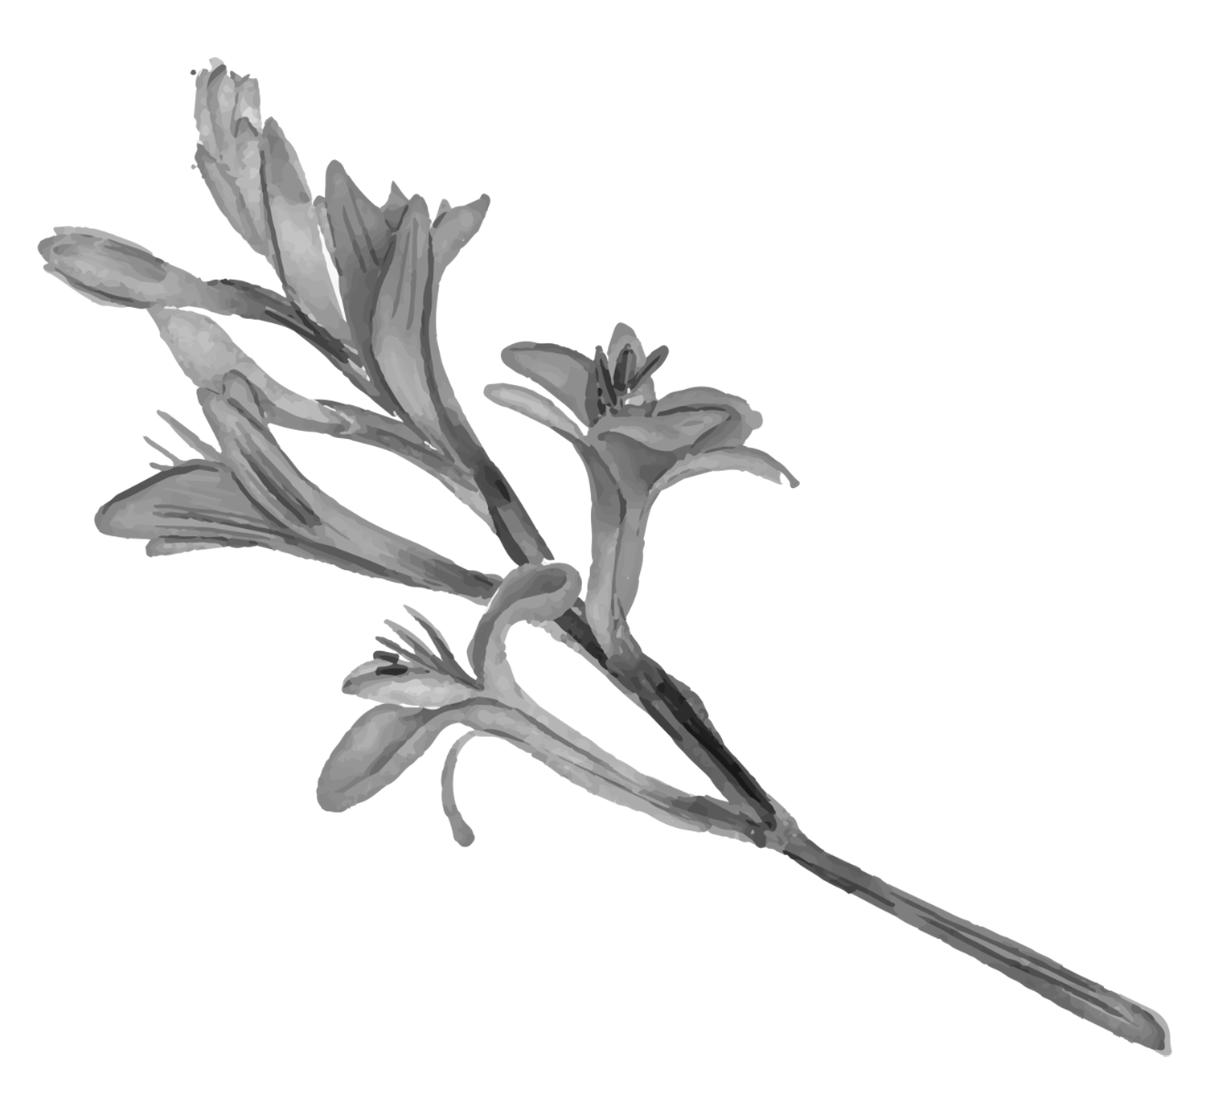
01
Homework checking

Slide 5
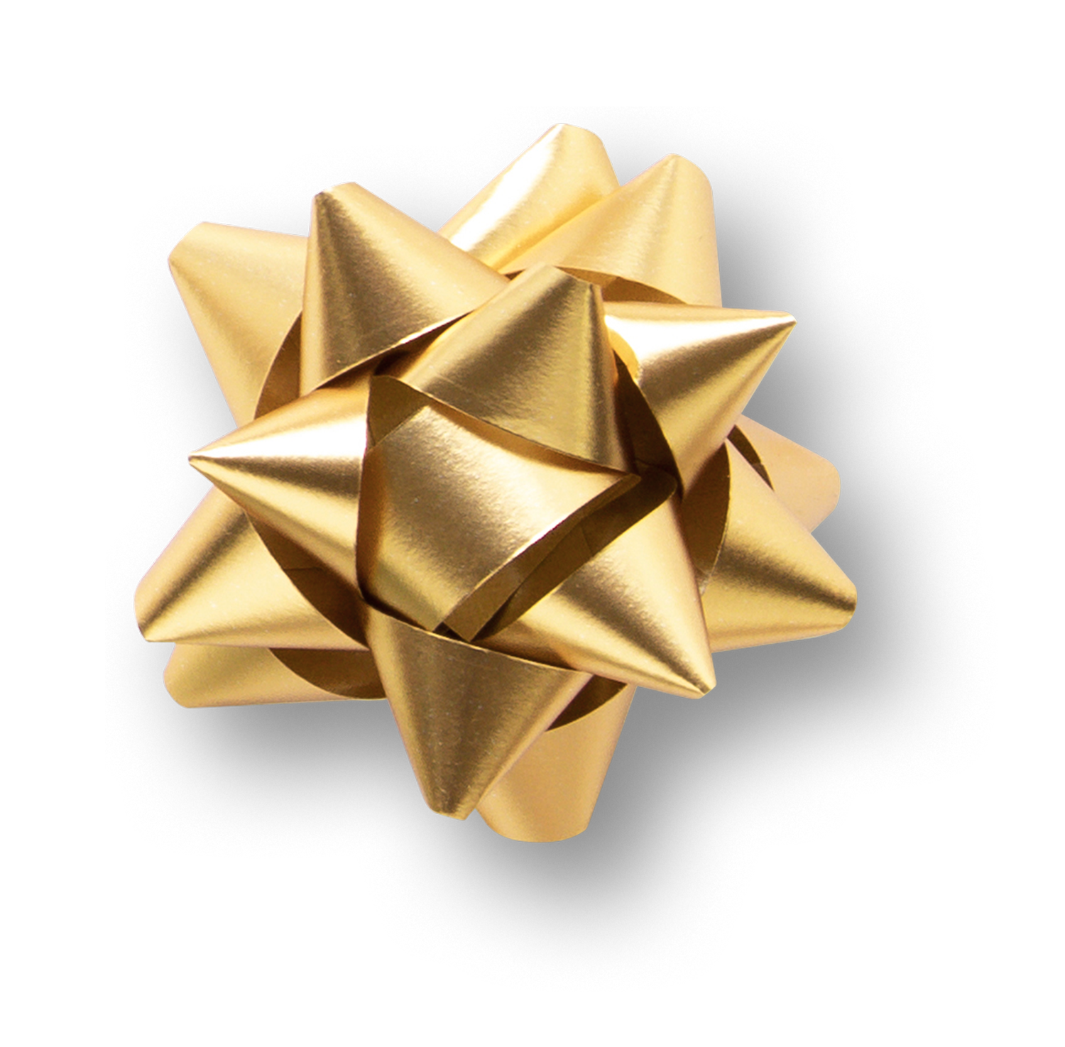
Homework checking
Natural wonders | Man-made wonders
One Pillar Pagoda
Phong Nha Cave
Saigon Notre-Dame Cathedral
Ha Long Bay
Po Nagar Cham Towers
Cuc Phuong National Park

Slide 6
Homework checking
Po Nagar Cham Towers
Ha Long Bay
One Pillar Pagoda
Cuc Phuong National Park
Saigon Notre-Dame Cathedral
Phong Nha Cave
Natural wonders | Man-made wonders

Slide 7
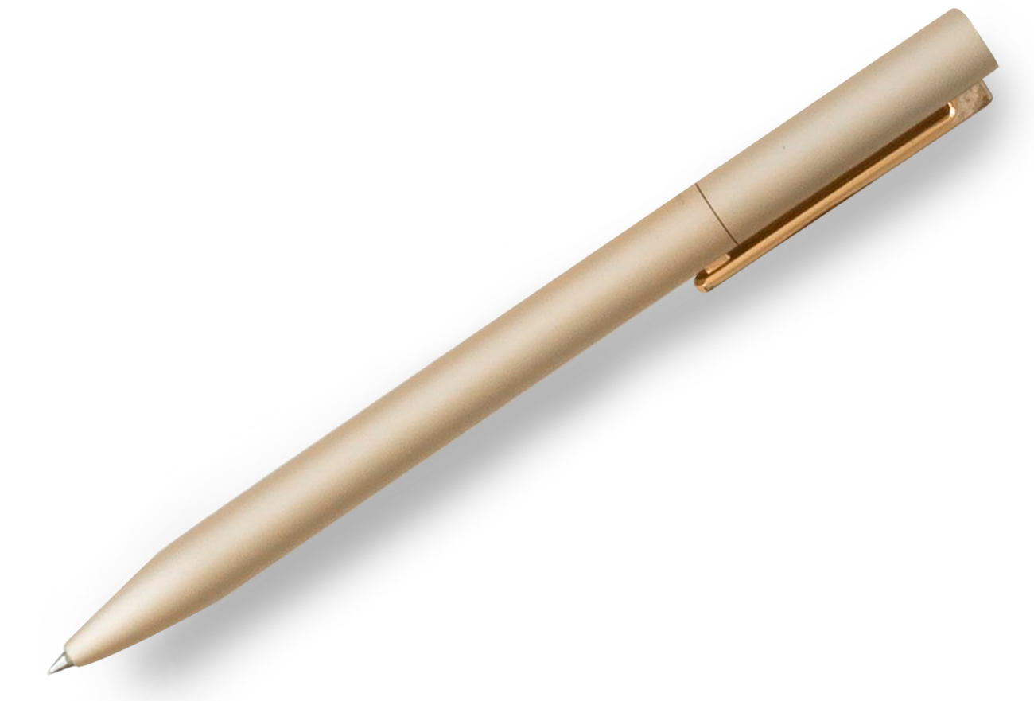
02
Vocabulary
“Look deep into nature, and then you will understand everything better.
- Albert Einstein -

Slide 8
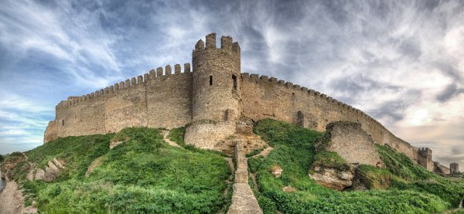
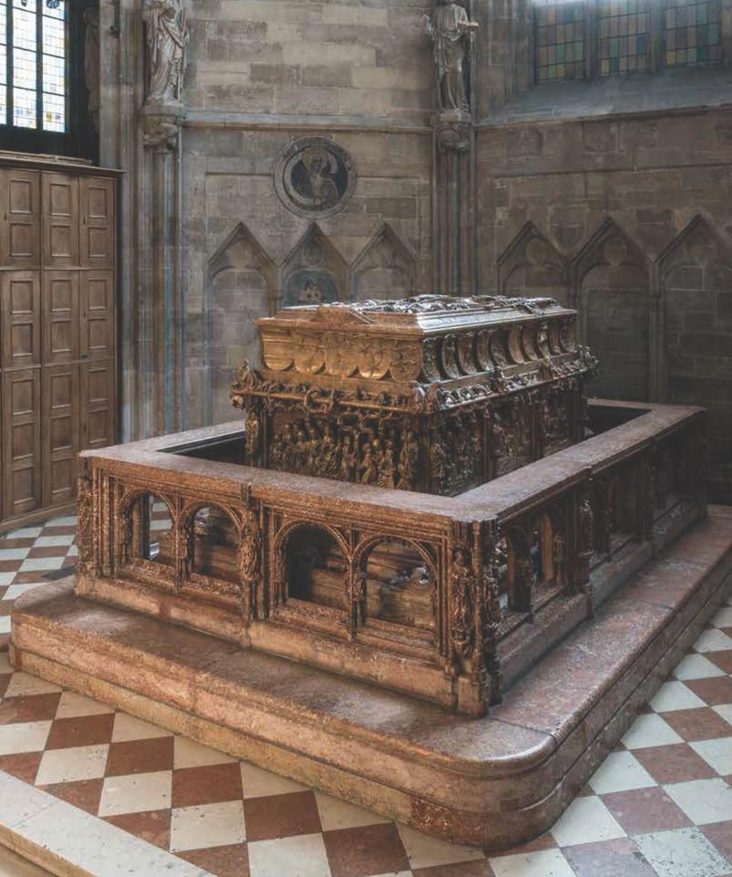
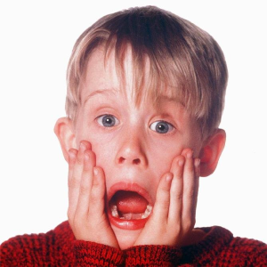
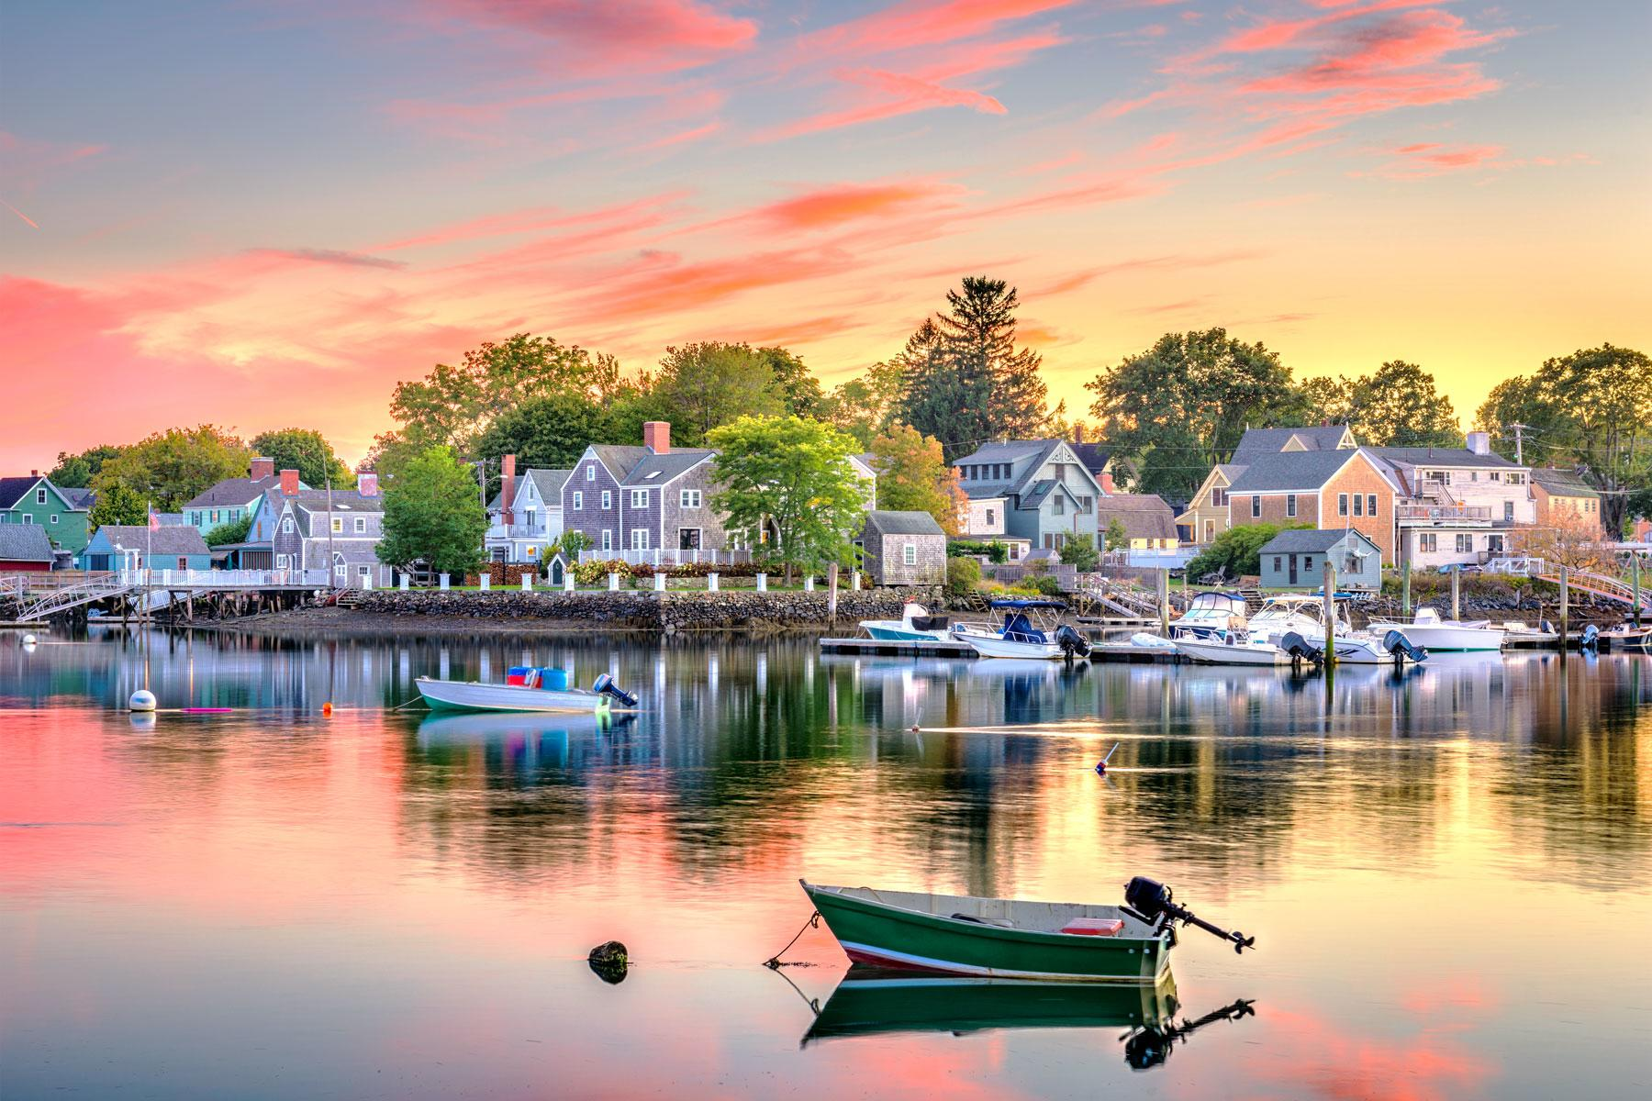
Awesome Words
Fortress
Tomb
/ˈfɔː.trəs/
(n) pháo đài
/tuːm/
(n) ngôi mộ
Picturesque
Astounding
/əˈstaʊn.dɪŋ/
(adj) kinh ngạc, sửng sốt
/ˌpɪk.tʃərˈesk/
(adj) đẹp như tranh vẽ
limestone /ˈlaɪmstəʊn/ (n) đá vôi
administrative /ədˈmɪnɪstrətɪv/ (adj) thuộc về hành chính
geological /ˌdʒiːəˈlɒdʒɪkl/ (adj) (thuộc) địa chất
measure /ˈmeʒə(r)/ (n) biện pháp, phương sách

Slide 9
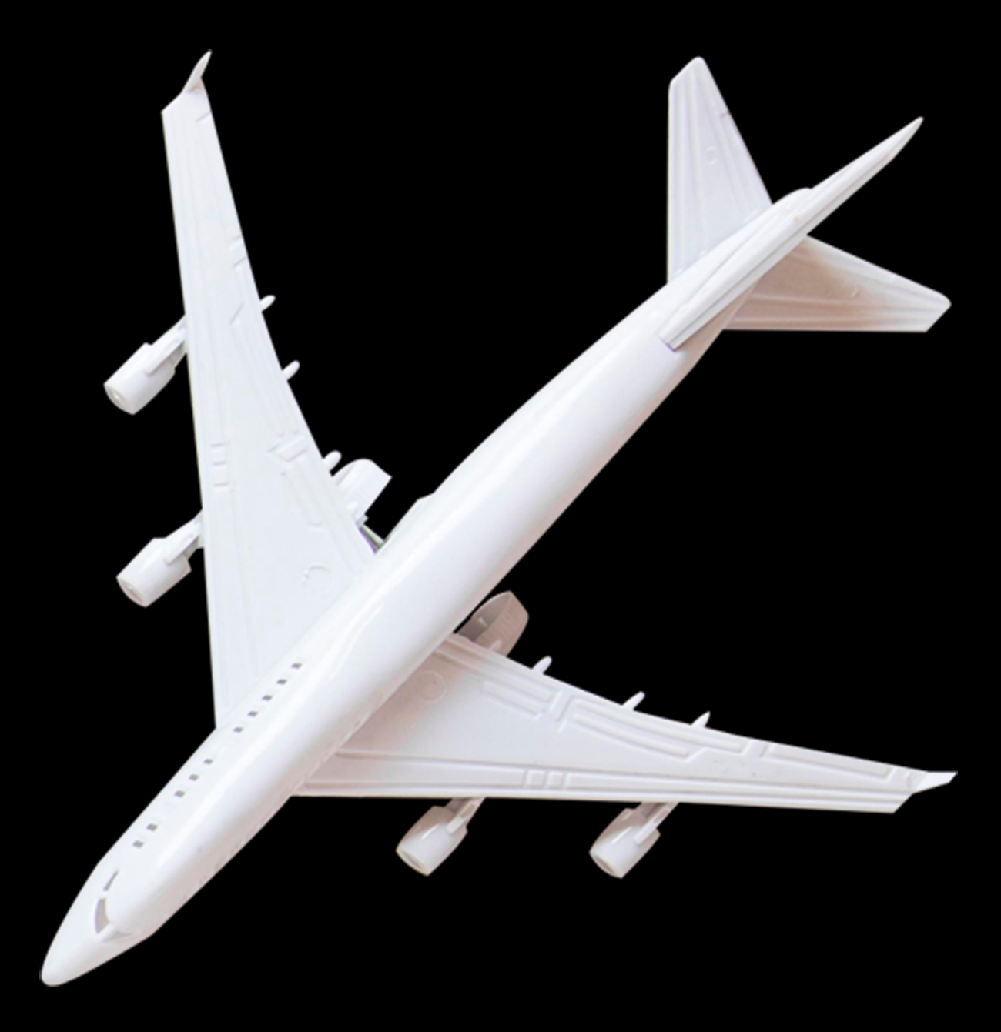
03
Pronunciation
Short words in a sentence
“We will open the book. Its pages are blank”

Slide 10
Short words
Articles (a, an , the)
Conjunctions (and, or)
Prepositions (at, of, to)

Slide 11
When the short words are used for citation.
When the short words are used for emphasis or contrast.
When the short words are used at the end of sentences.
Short words in a sentence
You shouldn’t put ‘and’ at the end of the sentence.
This is the place to eat.
Mary is the person I’m looking for.

Slide 12
Consolidation
Vocabulary
Pronunciation
Nouns and adjectives related to the topic “Wonders of Vietnam”
Short words in a sentence
HOME
BACKGROUNDS
AVATAR KIT
PLANNERS
HOMEWORK

Slide 13
Thanks!
Do you have any questions?
youremail@freepik.com
+34 654 321 432
yourwebsite.com
Please keep this slide for attribution

